Slide 1
INTRODUCING GEM: General-Purpose Electronic Measurement Division and the Agilent Truevolt 34460A / 34461A 6 ½ Digit DMMs
Jim Durr
Application Support Engineer
David Tu
Application Engineer
Public Introduction
June 17, 2013
34460A / 34461A
Slides and documents (√) available at: ftp://ftp.agilent.com/mpusup/3446xA/TCC_Training

Slide 2
GEM Marketing Organization

Slide 3
Application & Support Organization
Application Support Team
Fong Hong Kee
Application Team
Objective : Product Preference
Generation.
Technical Collaterals
Target Market Engagement
Training, Trade Show & e-Marketing
Support Team Yapp Poey Hee
Objective : Product Works as advertised
Service Levels
Warranty Cost
Training, e-Marketing
Lim, Hock Eng | Apps Focus : RF & Audio Product Contact : Power Meters
Lee, Chin Aik | Apps Focus : RF & Audio Product Contact : Audio Analyzer
Tan, See Kai | Apps Focus : Green Energy & Manufacturing Product Contact : Bench Instruments
Tu, David | Apps Focus : Green Energy & Manufacturing Product Contact : Bench Instruments
Wong, Sook Wai | Apps Focus : Maintenance & Installation Product Contact : Handhelds
Diller, Cheryl | Operations, Loveland
Chua, Teong Keat | Operations, Penang
Choi, Mun Ken | PMPS & Audio (Asia + Japan)
Durr, Jim | Counters, DMM, Pxi
Hornburg, Luke | FG, DMM
Lim, Say Heng | VEE, IO
Loh, Keh Teong | MI, Thermal, Hybrid, PLRO,PLPW
Wong, Seok Jin | HH, 5.5d DMM
Conway, Tom (NAW) | DAQ, DSA, DMM
Rose, Matthews (NAW) | PMPS & Audio (Americas + Europe)

Slide 4
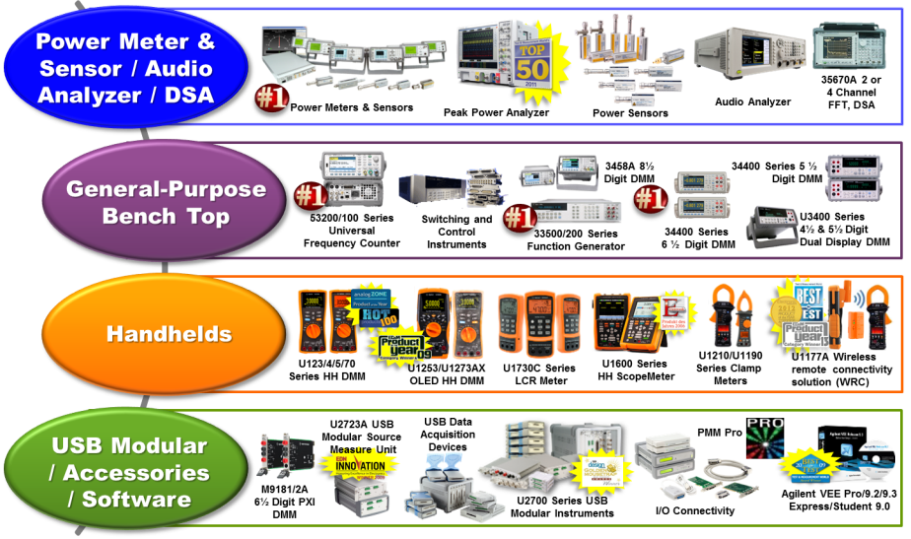
GEM Product Portfolio
We are #1 player in Power Meter/Sensor, Counter, DMM, & Function Generator

Slide 5
GEM Order Profile By Region

Slide 6
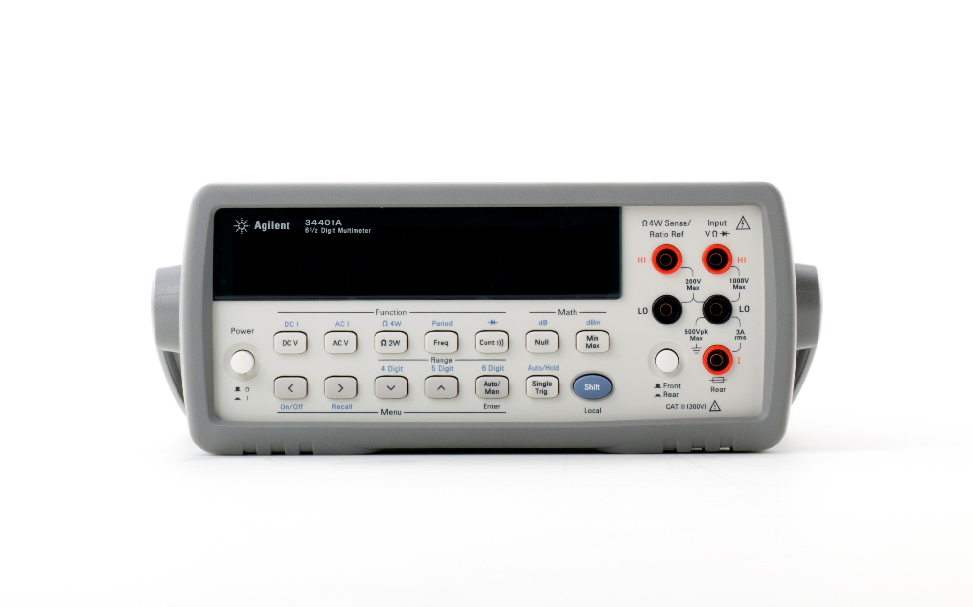
The 34401A 6½ Digit DMM
From customers:
“trusted”, “very reliable”, ”perfect product”,
“the workhorse”
Introduced in 1991
~400,000 units world-wide!!
Highest volume selling product in EMG history

Slide 7
Agilent Truevolt 34460A / 34461A 6 ½ Digit DMMs
Full 34401A SCPI compatibility (34461A is the direct replacement)
Designed by the same team of engineers as the 34401A
System Identify: Shift → Utility → System Setup → User Settings → SCPI ID SYSTem:IDENtify HP34401A
Notes:
7

Slide 8
Agilent Truevolt 34460A / 34461A 6 ½ Digit DMMs Full 34401A SCPI Compatibility
No compatibilty mode to enable - accepts 34401A commands directly
Programming and compatibilty differences document (√)
No 34401A Discontinuance date announced > anticipated: 7/2014 – 7/2015
√
http://cp.literature.agilent.com/litweb/pdf/5991-2367EN.pdf

Slide 9
Agilent Truevolt 34460A / 34461A 6 ½ Digit DMMs - A look at the products
34460A
34461A
Notes:
9

Slide 10
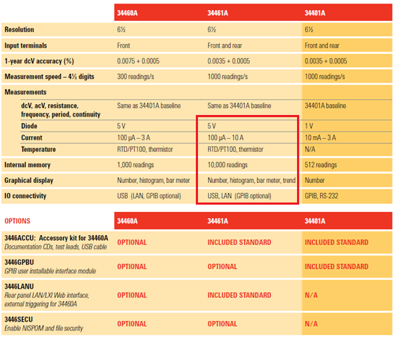
Agilent Truevolt 34460A / 34461A 6 ½ Digit DMMs - side by side comparisons
* Kit - no installation
* Customer Installable
* Software License
* Software License
Physical Dimensions (rack dimensions):
34460A/34461A: 272.3 mm (D) x 212.8 mm (W) x 88.3 mm (H) 34401A: 348.3 mm (D) x 212.6 mm (W) x 88.5 mm (H)

Slide 11
Agilent Truevolt 34460A / 34461A 6 ½ Digit DMMs - With no RS-232 interface, how is the 34461A a direct replacement?
RS-232 (PC) to LAN (Instrument) Converter identified
Proof of concept complete
Compatible with Agilent IO Libraries
Utilizes a LAN-Socket connection
Availability and configuration information posted on ‘GPETE’ blog http://gpete-neil.blogspot.com/
Not an Agilent supported interface configuration

Slide 12
Agilent Truevolt 34460A / 34461A 6 ½ Digit DMMs - Service and Support
3-year warranty (standard)
Whole Unit Exchange > Front panel/processor board > Fuses, battery, fan, bumpers > power module, transformer
1-year calibration Interval > adjust always (electronic adjustment) > standard and Z540.3

Slide 13
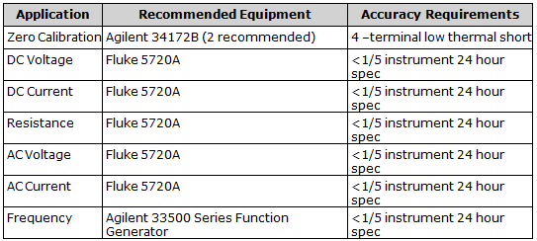
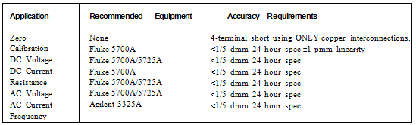
Agilent Truevolt 34460A / 34461A 6 ½ Digit DMMs - Service and Support
Can use existing 34401A Calibration Equipment
34460A/34461A
34401A

Slide 14
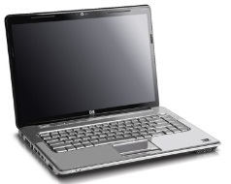



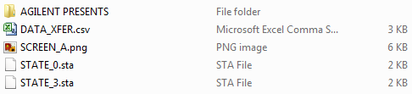

Agilent Truevolt 34460A / 34461A 6 ½ Digit DMMs - Product Features
USB File Transfer (drag/drop driverless connectivity)
Media Transfer Protocol (MTP) > Read only
> Data files (.csv)
> Instruments states (.sta)
> Images (bmp, png)
> Operating and Service Guide (pdf – 1.09 release)
USB Interface
Agilent IO Libraries (free)
USB
Access via Windows Explorer
Easy File Access
Windows Explorer View

Slide 15



Agilent Truevolt 34460A / 34461A 6 ½ Digit DMMs - Product Features
USB File Transfer (drag/drop driverless connectivity)
Modes of Operation: Shift → Utility → I/O Config → USB Settings
- Composite: drag/drop and USB programming
- USB: USB programming only
- MTP: Drag/drop only, no USB programming or IO Library access
Composite and USB modes change the USB address – alias is not changed
34461A – file access on (1C07), file access off (1A07)
34460A – file access on ( 1D07), file access off (1B07)
Easy File Access

Slide 16


Agilent Truevolt 34460A / 34461A 6 ½ Digit DMMs - Product Features
USB File Transfer (drag/drop driverless connectivity)
Shift → Utility → I/O Config → USB Settings → File Access (On)
Shift → Utility → I/O Config → USB Settings → File Access (Off)
Windows XP: Requires Microsoft Windows Media Player 11 for XP
Restricted function: instrument security must be unlocked
Power cycle required to enable/disable setting
Not supported on Mac/Safari
Easy File Access

Slide 17

Agilent Truevolt 34460A / 34461A 6 ½ Digit DMMs - Product Features
USB File Transfer (drag/drop driverless connectivity)
Example
Acquire → Trg Src (Single) → Samples/Trigger → Single → Save Readings (Internal)
Open Explorer and scroll to Agilent DMM
Easy File Access

Slide 18
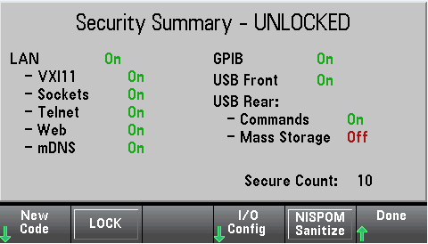
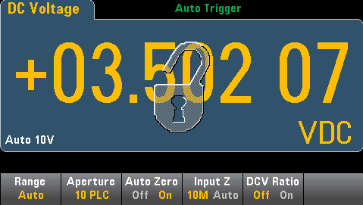
Agilent Truevolt 34460A / 34461A 6 ½ Digit DMMs - Product Features
Instrument Security / NISPOM Sanitization (product Option SEC)
Shift → Utility → Test/Admin → Security → Secure Code (unlock)
Factory setting: AT3446XA
Security code override – procedure in operating/service guide
Security document location: (√) www.agilent.com/find/security

Slide 19
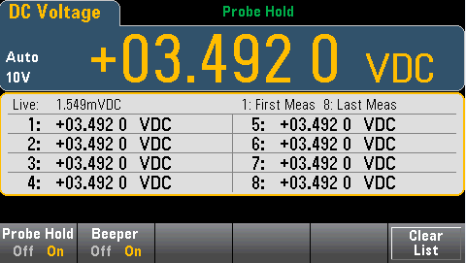
Agilent Truevolt 34460A / 34461A 6 ½ Digit DMMs - Product Features
Probe Hold
Shift → Probe Hold → Probe Hold (On)
Audible ‘beep’ when reading is obtained
Last 8 measured values listed (readings scroll)
Allows focus on test points rather than DMM display

Slide 20
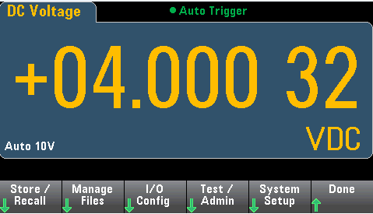
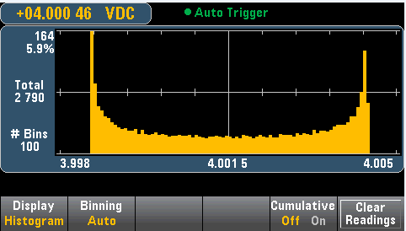
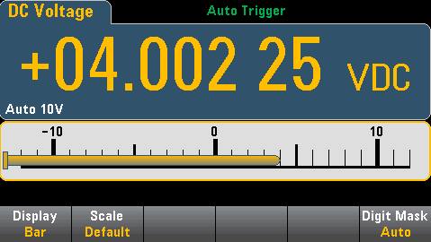
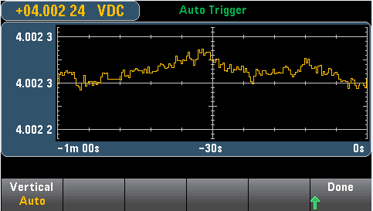
Agilent Truevolt 34460A / 34461A 6 ½ Digit DMMs - Product Features
Graphical Displays
Number
Histogram
Bar Meter
Display → Display
Trend Chart

Slide 21
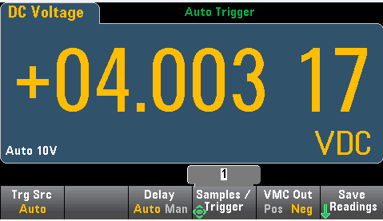
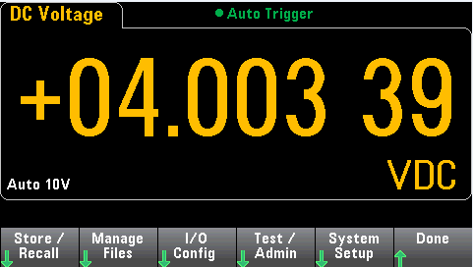
Agilent Truevolt 34460A / 34461A 6 ½ Digit DMMs - Product Features
Selectable back ground colors
Shift → Utility → System Setup → User Settings → Display Options → Colors

Slide 22
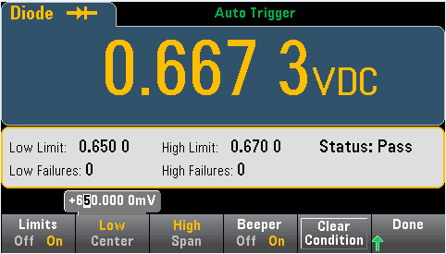
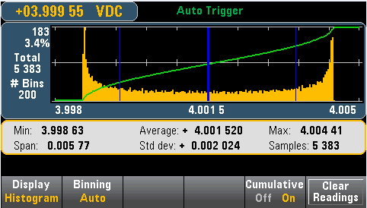
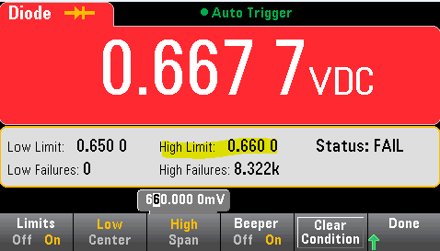
Agilent Truevolt 34460A / 34461A 6 ½ Digit DMMs - Product Features
Limits and Statistics
Shift → Math → Limits → Limits Shift → Math → Statistics → Statistics
Graphical representation of mean and 1-σ standard deviation; cumulative frequency distribution

Slide 23
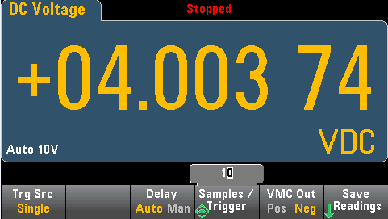
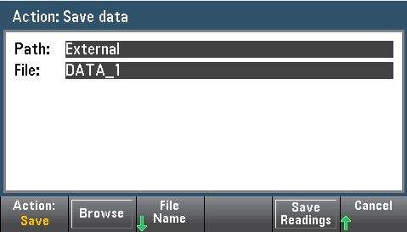
Agilent Truevolt 34460A / 34461A 6 ½ Digit DMMs - Product Features
Save readings within any display mode
Acquire → Trg Src (Single) → Samples / Trigger → Single → Save Readings

Slide 24
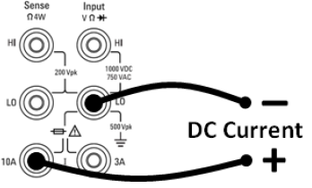
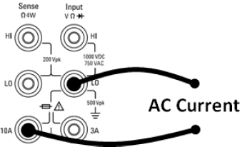
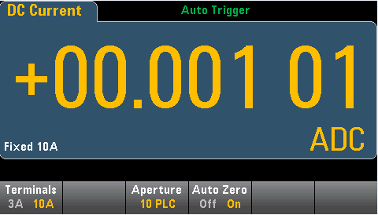
Agilent Truevolt 34460A / 34461A 6 ½ Digit DMMs - Product Features
10A Current Range
6 ½ Digit Resolution
34461A only
Front panel terminals only
Current path fuse located internally

Slide 25
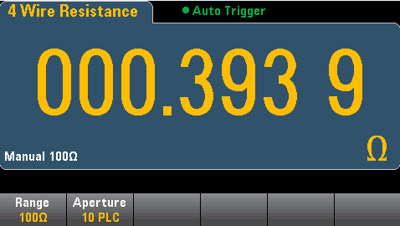
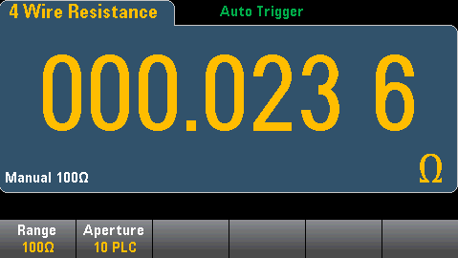
Agilent Truevolt 34460A / 34461A 6 ½ Digit DMMs - Product Features
10A Current Range
Reduce burden voltage through less shunt resistance
34461A 3A current shunt resistance
34461A 10A current shunt resistance

Slide 26
Agilent Truevolt 34460A / 34461A 6 ½ Digit DMMs - Product Features
Temperature Measurements
Temp → Probe
Thermistor: 5k (2W/4W)
RTD: PT100 (2W/4W)

Slide 27
Agilent Truevolt 34460A / 34461A 6 ½ Digit DMMs - Product Features
Help System
Press and hold any key (hard or soft) for context-sensitive help
Shift → Utility → System Setup → User Settings → Help Lang
Help languages: English, French, German, Japanese, Korean,
Chinese, Russian

Slide 28
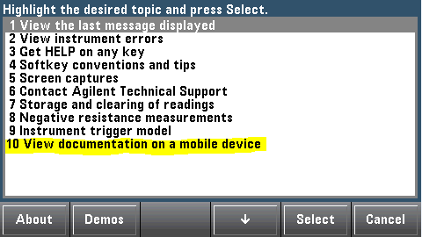
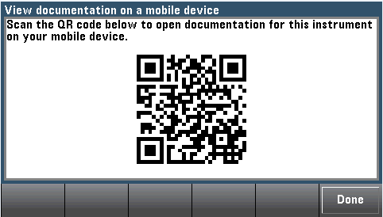
Agilent Truevolt 34460A / 34461A 6 ½ Digit DMMs - Product Features
“Mobile Optimized” Documentation (eDoc)
Shift → Help → Select
→
1. Scan the QR code directly from the instrument front panel to view
the operating and service guide.

Slide 29
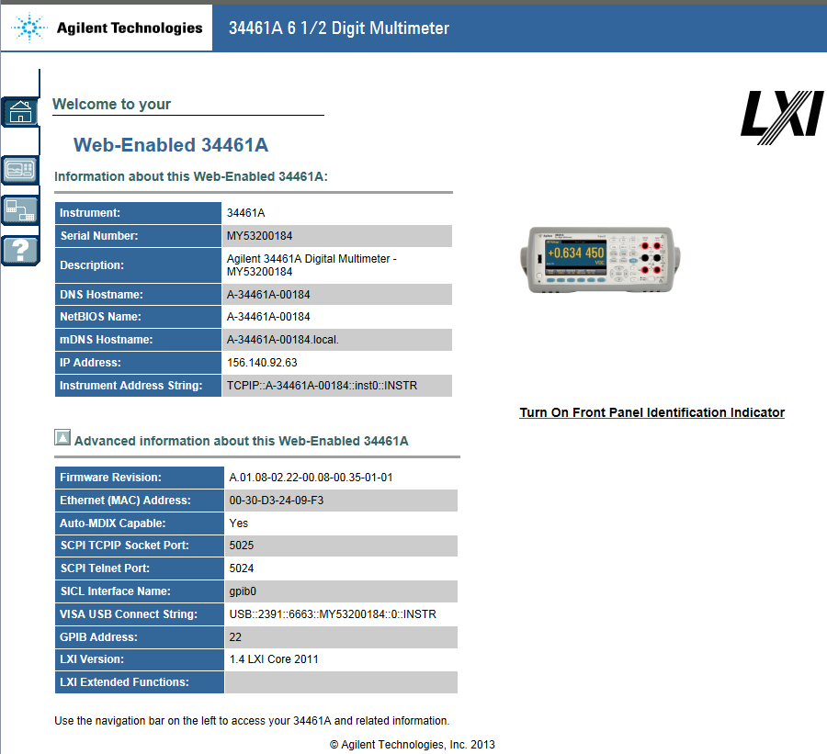

Agilent Truevolt 34460A / 34461A 6 ½ Digit DMMs - Product Features
Web UI

Slide 30
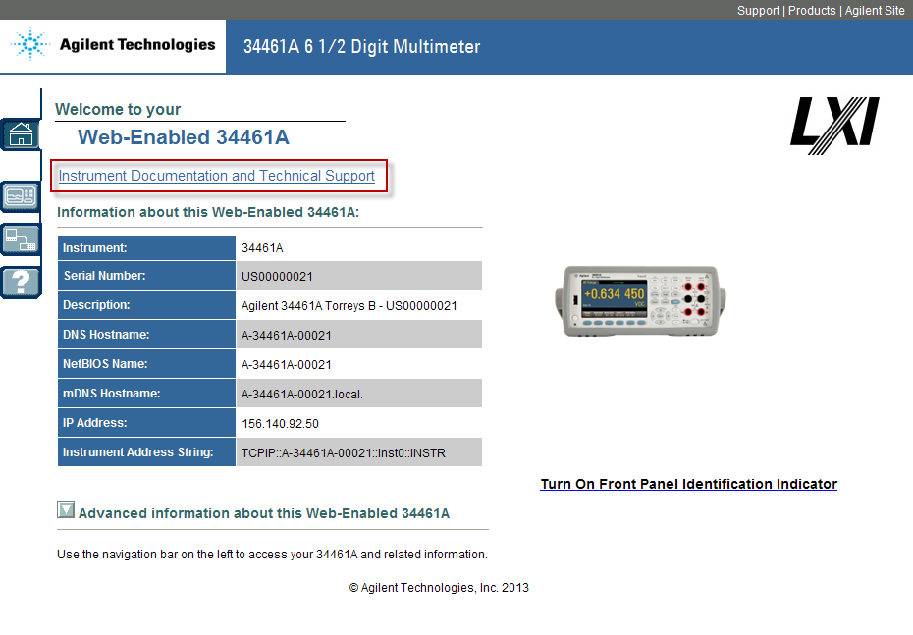
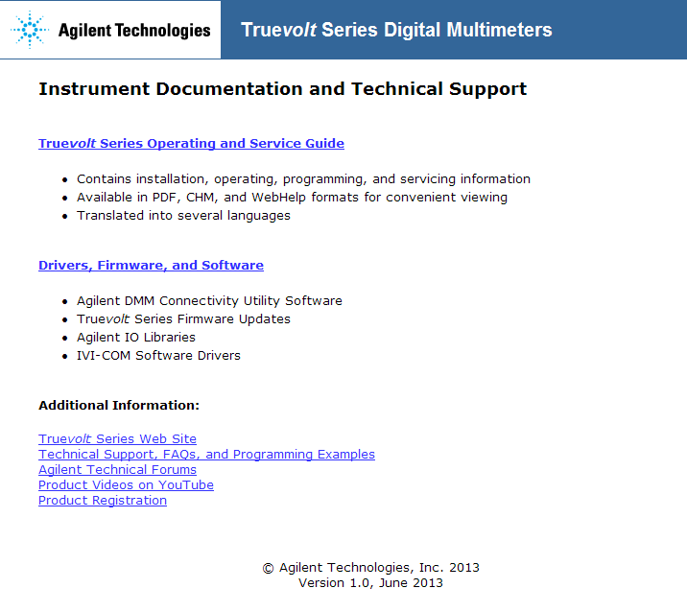
Agilent Truevolt 34460A / 34461A 6 ½ Digit DMMs - Product Features
Web UI – release 1.09
Will eventually replace the Product
Reference CD

Slide 31
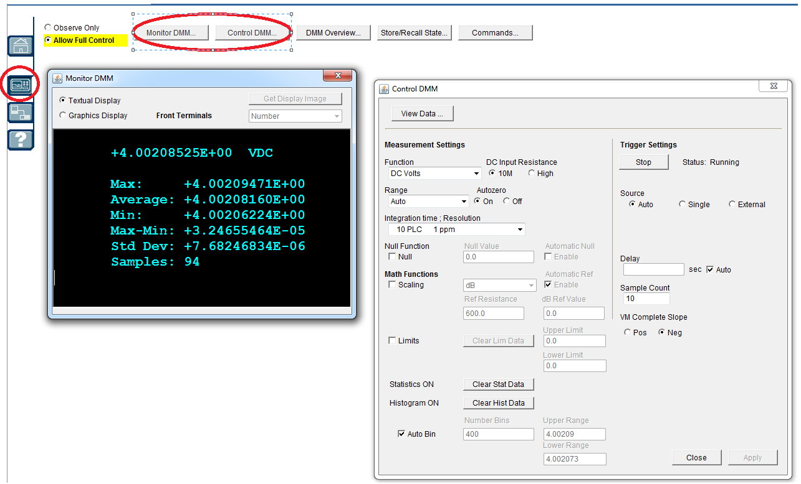
Agilent Truevolt 34460A / 34461A 6 ½ Digit DMMs - Product Features
Web UI – Monitor DMM/Control DMM

Slide 32
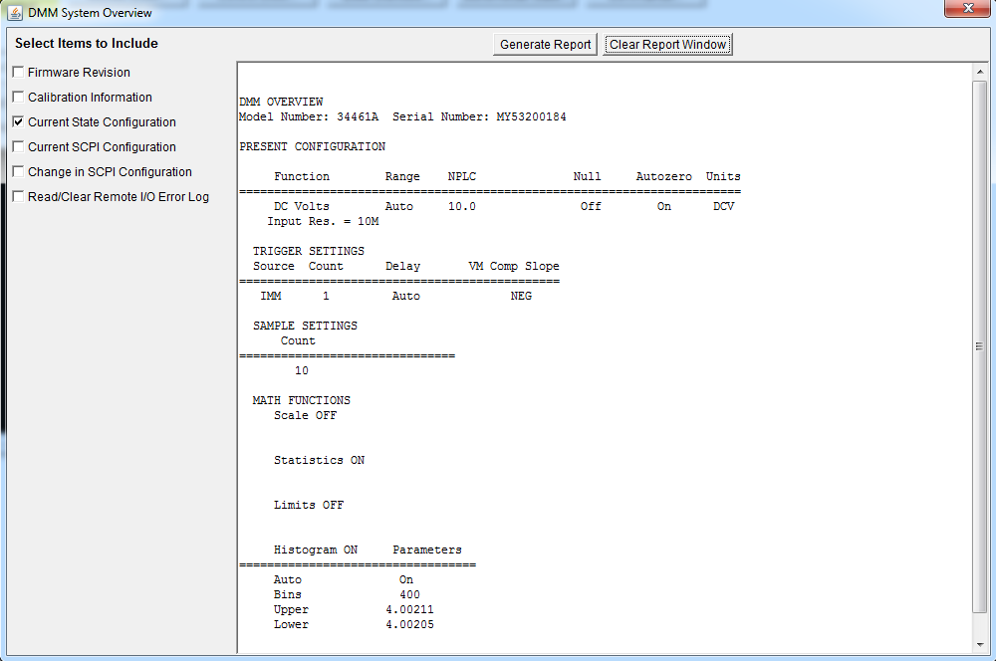
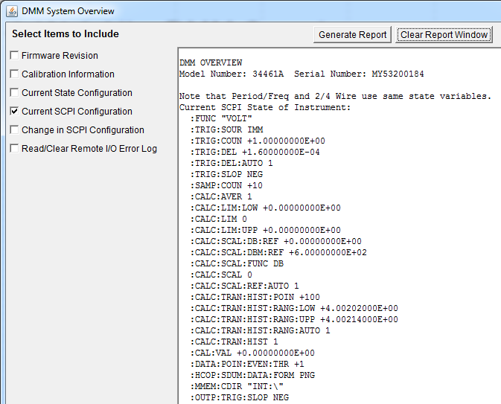
Agilent Truevolt 34460A / 34461A 6 ½ Digit DMMs - Product Features
Web UI – DMM Overview / Current SCPI Configuration
*LRN? String

Slide 33

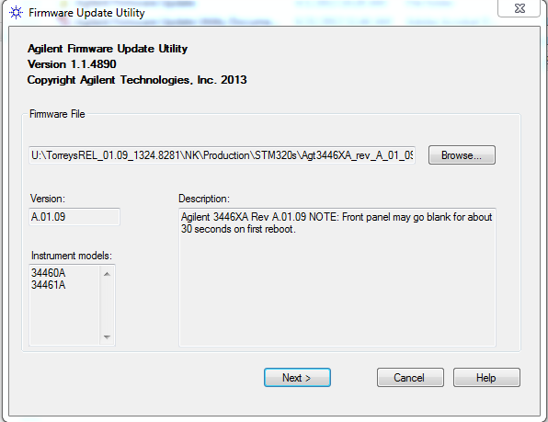
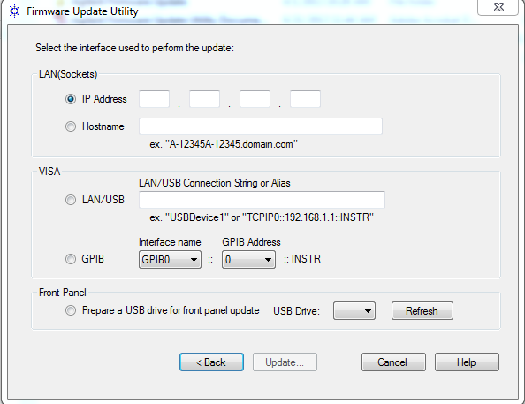
Agilent Truevolt 34460A / 34461A 6 ½ Digit DMMs - Product Features
Firmware Update Utility
New Utility Allows update using LAN, GPIB, or USB Interface

Slide 34
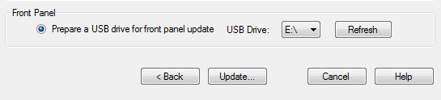
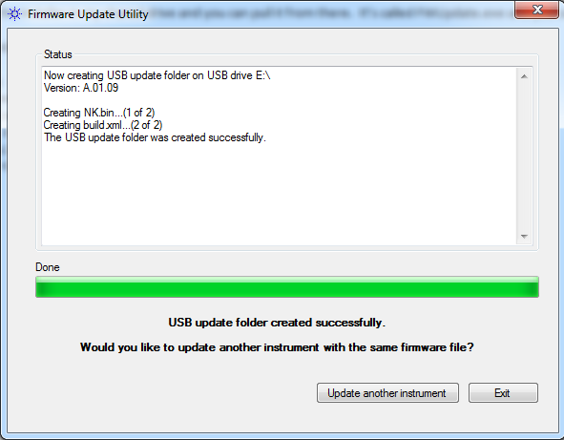

Agilent Truevolt 34460A / 34461A 6 ½ Digit DMMs - Product Features
Firmware Update Utility
Front Panel USB Host Port
> automatic USB drive configuration
Press ‘Update… to create required directory and files on USB root

Slide 35
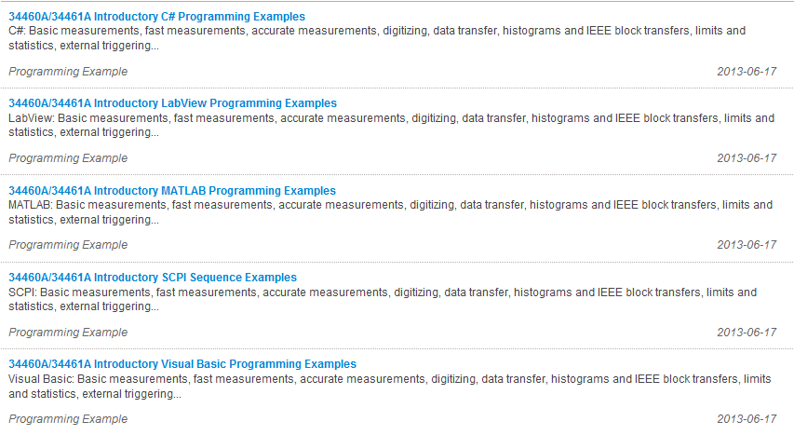
Agilent Truevolt 34460A / 34461A 6 ½ Digit DMMs - Product Features
On-Line Examples
http://www.agilent.com/find/34461A
Visit Technical Support → Drivers, Firmware, & Software

Slide 36
Agilent Truevolt 34460A / 34461A 6 ½ Digit DMMs - Product Features
Videos
Digital Multimeter Programming in Visual Studio
https://www.youtube.com/watch?v=GwZ2Kv9L-Xg
Digital Multimeter MATLAB Programing Example
https://www.youtube.com/watch?v=lVpMH4NDOpE

Slide 37
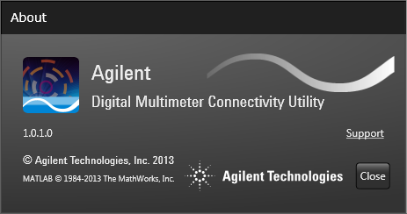
Agilent Truevolt 34460A / 34461A 6 ½ Digit DMMs - Digital Multimeter Connectivity Utility
www.agilent.com/find/DMMUtilitysoftware

Slide 38
Agilent Truevolt 34460A / 34461A 6 ½ Digit DMMs - Digital Multimeter Connectivity Utility
System Requirements
PC Operating Systems (Supported)
- Windows 8, 32-bit and 64-bit (Windows 8, Windows 8 Pro)
- Windows 7, SP1 32-bit and 64-bit (Professional, Enterprise, Ultimate)
- Windows XP, SP3 32-bit (Professional)
PC Hardware
- Windows 8 and Windows 7:
Processor: 1 GHz or faster (2 GHz or greater recommended)
RAM: 1 GB (32-bit) or 2 GB (64-bit) (3 GB or greater recommended)
Windows XP:
Processor: 600 MHz or faster (1 GHz or greater recommended)
RAM: 512 MB (1 GB or greater recommended)
Web connection required for installation and upgrades

Slide 39
Agilent Truevolt 34460A / 34461A 6 ½ Digit DMMs - Digital Multimeter Connectivity Utility
Supported Instruments
Agilent 34401A, 34405A, 34410A, 34411A, 34450A, 34460A, and 34461A DMMs.
Note:
- Digitizing is supported only on 34410A, 34411A, 34460A, and 34461A DMMs
- Does not work with 3458A, 34420A, L4411A or any PXI DMM
- Does not support any Handheld DMMs or U3400 series
- Up to 9 DMMs per connectivity session (tested)
Supported Interfaces
USB, GPIB, LAN, RS-232.
Requires Agilent IO Libraries Suite v16.0 or later
Works with NI Max

Slide 40
Agilent Truevolt 34460A / 34461A 6 ½ Digit DMMs - Digital Multimeter Connectivity Utility
Installation
104MB download – no CD, web distribution only
Automatically installs required dependencies
Included in the install package
- .NET 4.0
- MATLAB binary (for export)
- Agilent connectivity fabric
IO Libraries are automatically downloaded and installed if required

Slide 41
Agilent Truevolt 34460A / 34461A 6 ½ Digit DMMs - Digital Multimeter Connectivity Utility
Basic Operation
Starts by reading DMM state, app does not have pre-defined state
Direct control of SCPI functions
Available functions reflect features of connected DMM
Actions take effect immediately (commands are sent to instrument as functions are changed)

Slide 42
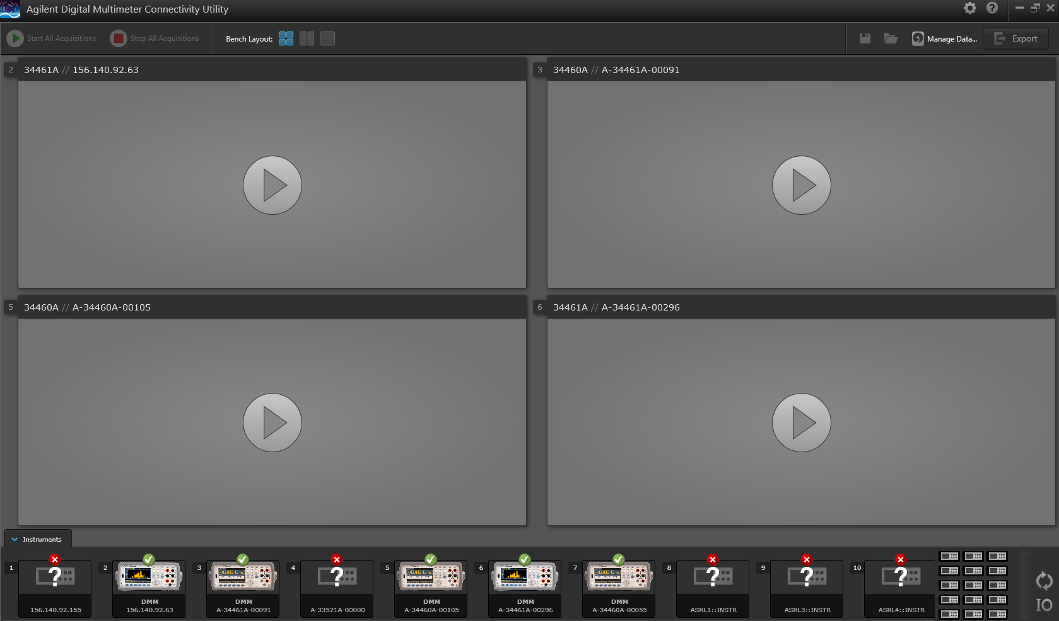
Agilent Truevolt 34460A / 34461A 6 ½ Digit DMMs - Digital Multimeter Connectivity Utility

Slide 43

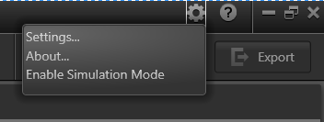
Agilent Truevolt 34460A / 34461A 6 ½ Digit DMMs - Digital Multimeter Connectivity Utility
Basic Operation – The Bench
Start an App (App states)
Play All/Stop All
Panel Views
Simulation Mode

Slide 44
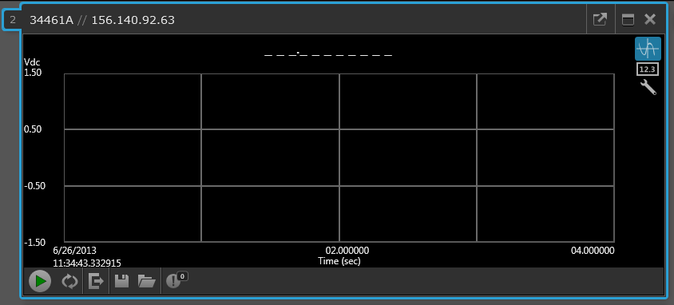
Agilent Truevolt 34460A / 34461A 6 ½ Digit DMMs - Digital Multimeter Connectivity Utility
Basic Operation – Pop in/out
Access to instrument control

Slide 45
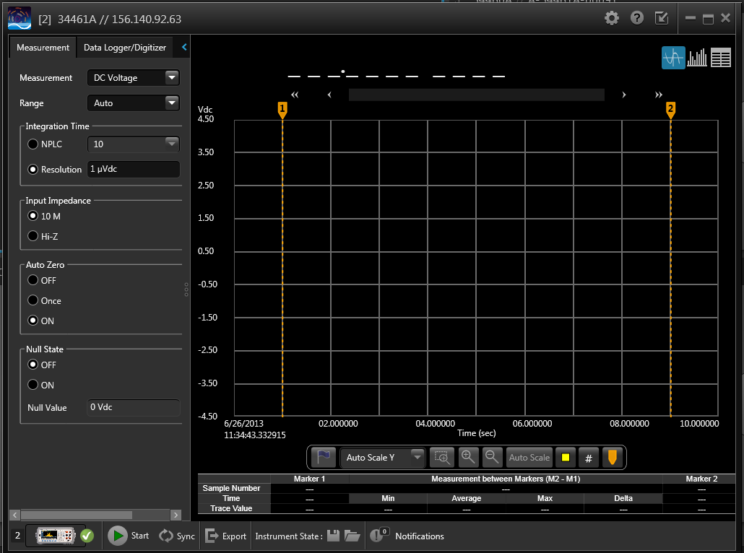
Agilent Truevolt 34460A / 34461A 6 ½ Digit DMMs - Digital Multimeter Connectivity Utility
Basic Operation – Pop in/out

Slide 46
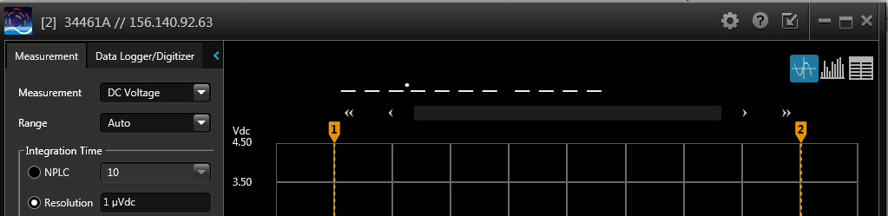
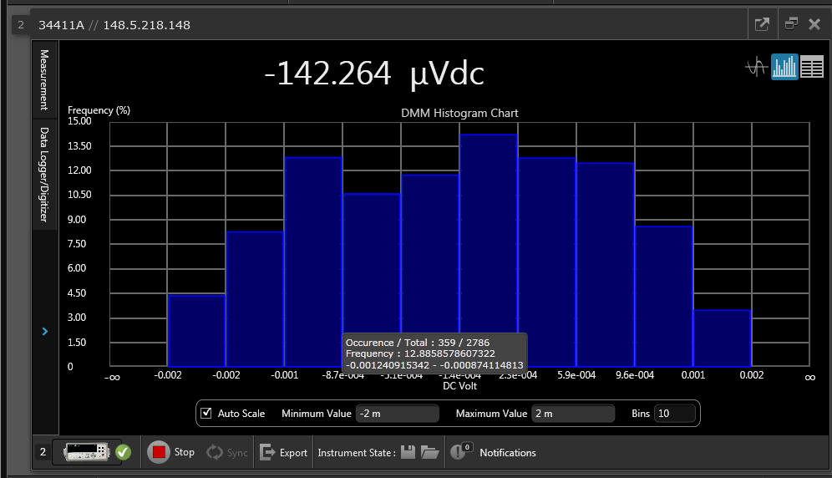
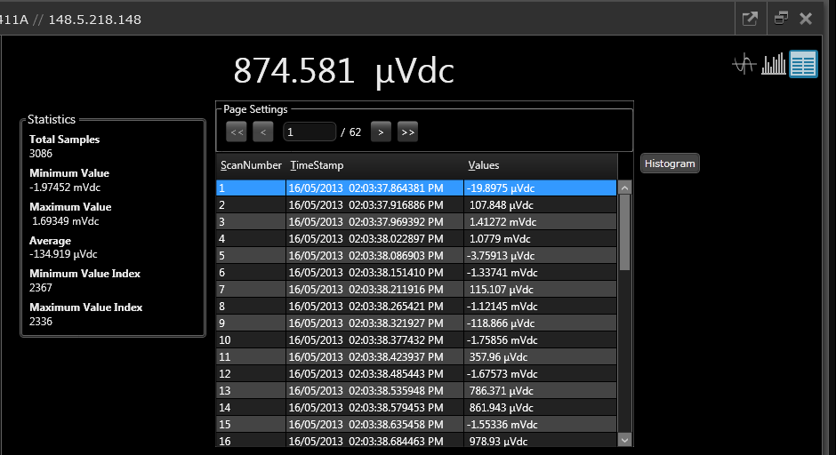
Agilent Truevolt 34460A / 34461A 6 ½ Digit DMMs - Digital Multimeter Connectivity Utility
Basic Operation – Histogram and Table Views

Slide 47
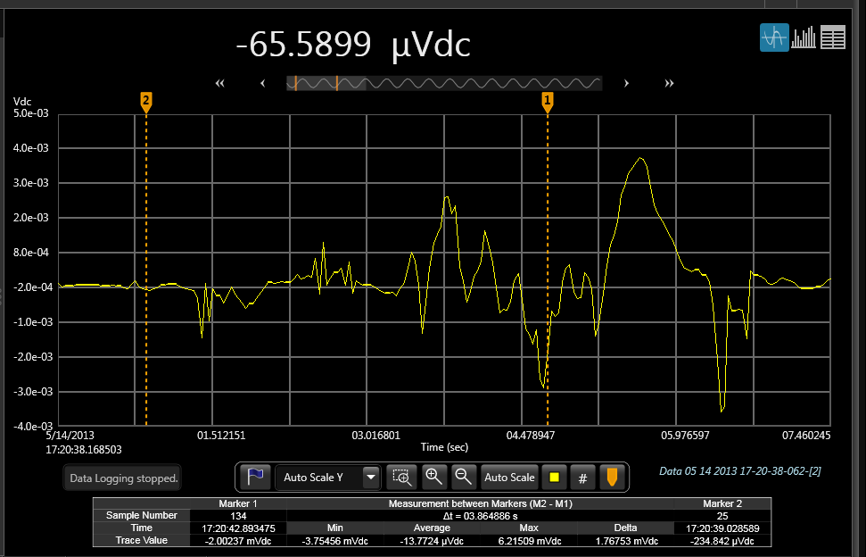
Agilent Truevolt 34460A / 34461A 6 ½ Digit DMMs - Digital Multimeter Connectivity Utility
Chart Features
Zooming/Panning
Markers
Measurements
Axis Labels
Auto Scroll
Scale and Autoscale Y

Slide 48
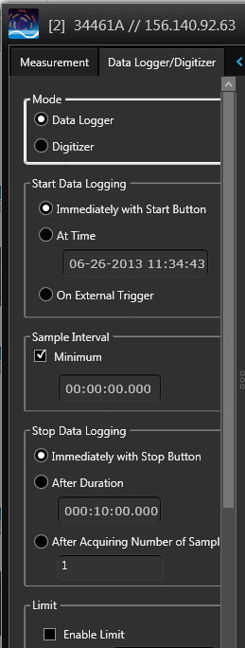
Agilent Truevolt 34460A / 34461A 6 ½ Digit DMMs - Digital Multimeter Connectivity Utility
Datalogger/Digitizer
Datalogging – PC Paced
- Measurement rate
can be paced by DMM settings
PC paced measurements have 20ms min (approx.)
- Flexible start/stop control
- Alarms with notification

Slide 49
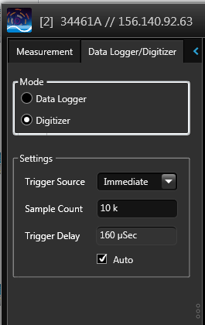
Agilent Truevolt 34460A / 34461A 6 ½ Digit DMMs - Digital Multimeter Connectivity Utility
Datalogger/Digitizer
Digitizer – DMM paced
Pre-trigger samples not supported

Slide 50

Agilent Truevolt 34460A / 34461A 6 ½ Digit DMMs - Digital Multimeter Connectivity Utility
Exporting Data Files
Export
- Exports all data
- Select range to limit size
- Bench level export is different than app
- MATLAB not required for export to MATLAB files
Data File Compatibility
- Can open Intuilink DMM setup files
- Exports to CSV, MATLAB, Excel, Work
- Bitmaps saved as BMP, JPG, PNG
- Data logs saved in proprietary format, use data manger to export

Slide 51
Agilent Truevolt 34460A / 34461A 6 ½ Digit DMMs - Digital Multimeter Connectivity Utility
Exporting Data Files
Data log files stored in a fixed directory location
Files cannot be viewed directly
No limit on file size or data log period
Performance decrease above 100k points

Slide 52


Agilent Truevolt 34460A / 34461A 6 ½ Digit DMMs - Digital Multimeter Connectivity Utility
Example (digitizing)
Input: 1 Hz, 2 Vpp sine wave
Set up Mode: Digitizer Measurement: DC voltage Range: 1V NPLC: 0.02 Impedance: 10M Auto Zero: Off Mode: Digitizer Trigger Source: Immediate Sample count: 10k Trigger Delay: 92 uSec

Slide 53

Agilent Truevolt 34460A / 34461A 6 ½ Digit DMMs - Digital Multimeter Connectivity Utility
Example (digitizing)
At a 1 Hz rate and a sample count of 10k readings, 10 cycles in the graph represent 1000 readings/second. Setting a trigger delay of 92 us produces almost exactly 1000 readings/second. Setting a delay of 0s results in the readings being acquired over approximately 9 cycles (> 1000 readings/second).

Slide 54


Agilent Truevolt 34460A / 34461A 6 ½ Digit DMMs - Digital Multimeter Connectivity Utility
Example (digitizing - exporting)
Exports from “main” tile

Slide 55


Agilent Truevolt 34460A / 34461A 6 ½ Digit DMMs - Digital Multimeter Connectivity Utility
Additional Features
SCPI Log / Instrument Reset
- from “pop out” window

Slide 56


Agilent Truevolt 34460A / 34461A 6 ½ Digit DMMs - Digital Multimeter Connectivity Utility
Additional Features
Application Help
- from “pop out” window - additional help topics
- from “main” tile

Slide 57
Agilent Truevolt 34460A / 34461A 6 ½ Digit DMMs - Digital Multimeter Connectivity Utility
Issues
If PC enters ‘sleep mode’ while data logging the utility must be restarted
.NET install time: on some XP systems installation of .NET may take 45 minutes or hours to complete. Not common, but it has occurred and will eventually complete.
Initial startup may result in a error if after started too soon after installation
DMM can lockup if timeouts occur. Use device clear or reset the DMM

Slide 58

Agilent Truevolt 34460A / 34461A 6 ½ Digit DMMs - Digital Multimeter Connectivity Utility
Mobile Application
Mobile Devices
Apple iPhone, iPad, iPod Touch all models; iOS 5.0 and later
Connects directly to LAN DMMs (no LAN-GPIB converters)
Only works while the app is active
Does not data log or digitize while it is in background
Be aware of iPad memory limitations
Delete the application to clear the data files
www.agilent.com/find/DMMUtilitysoftware

Slide 59

Q&A

Slide 60


Agilent Truevolt 34460A / 34461A 6 ½ Digit DMMs - A look at the products
Notes:
60

